Slide 1
PNG For CHRIST
“This is the LORD's doing; it is marvellous in our eyes.”
Psalm 118:23
PNG4Christ: Digital Discipleship

Slide 2
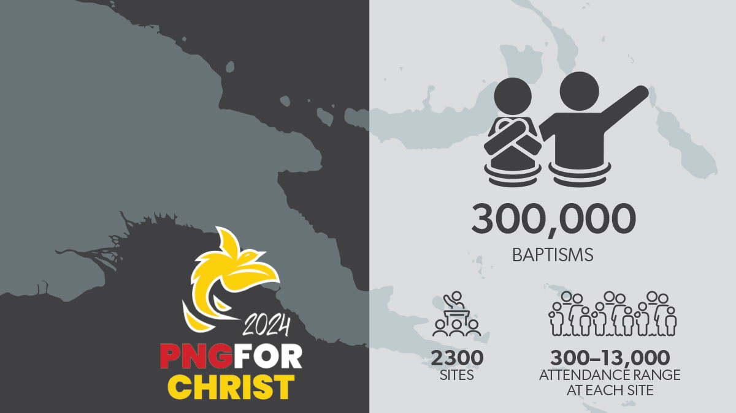
PNG4Christ: Digital Discipleship

Slide 3
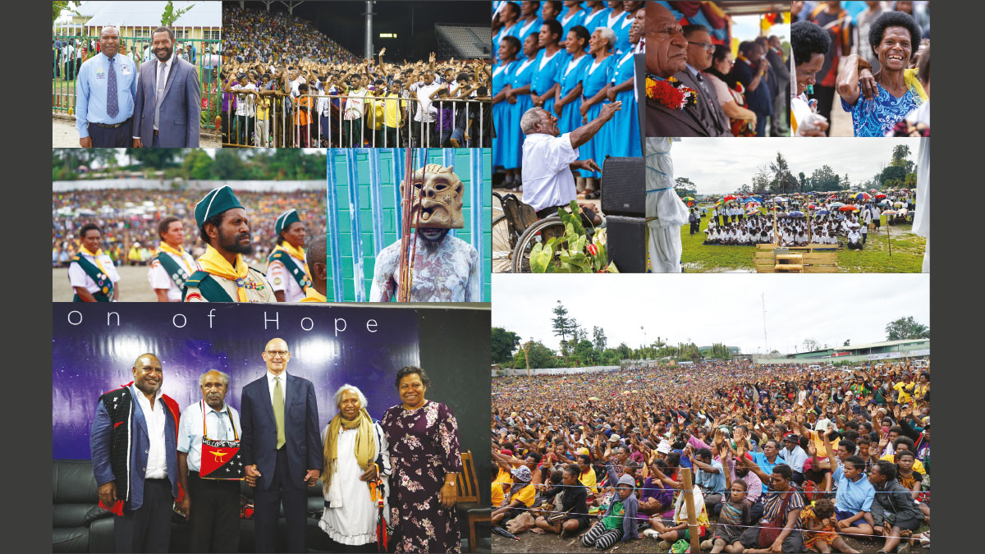
PNG4Christ: Digital Discipleship

Slide 4
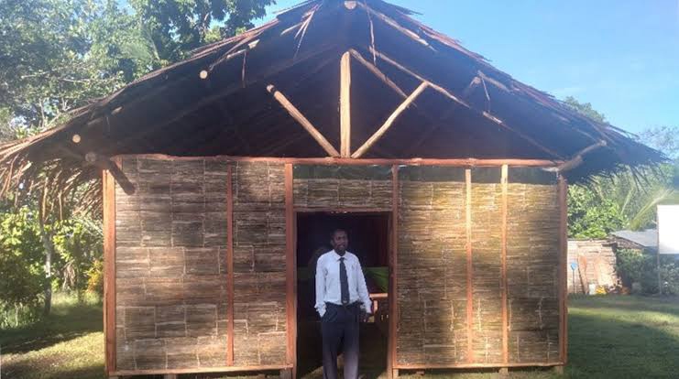

Slide 5
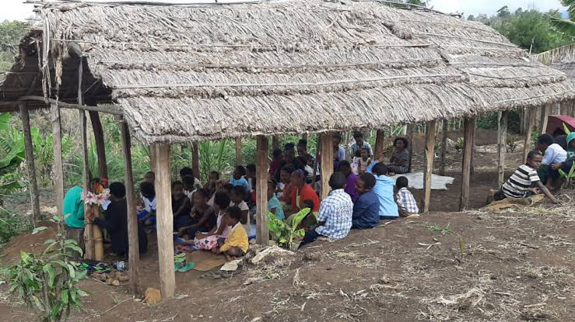

Slide 6
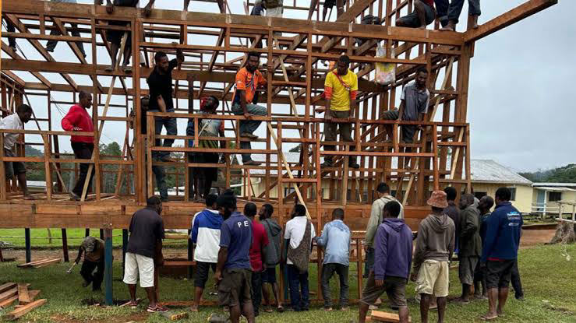

Slide 7
Digital landscape
Internet Access: 24.1% of PNG’s population are internet users (~2.57 million people).
Mobile Phone Connections: 47.2% of the population (~5.03 million mobile connections).
Social Media Users: 12.2% of the population (~1.3 million users), with Facebook dominating.
Television Access: Estimated 31% of rural and 66% of urban households have some level of access.
Source: DataPortal
PNG4Christ: Digital Discipleship

Slide 8
Youth digital-centric
PNG has a very young population, with over 50% under 24 years old.
Smartphone usage is rising, with more people accessing social media than ever before.
Digital evangelism is key to reaching younger demographics who spend time online.
Source: DataPortal
PNG4Christ: Digital Discipleship

Slide 9



TESTIMONIALS
Who?
Involvement?
Learning?
PNG4Christ: Digital Discipleship

Slide 10
“Going Mainstream”
Integration
Relevance
Enablers
Tech into Church Business
ICT+Media = Convergence
Involve Members = Discipleship
Open door evangelism
Other? Homes, Hotels, Offices, Mobile Phones?
Authentic Story Telling
From ‘Digital’ to ‘In-person’
Organizational Restructuring
Infrastructure and Tools
PNG4Christ: Digital Discipleship

Slide 11
“WHATEVER MAY HAVE BEEN YOUR FORMER PRACTICE, IT IS NOT NECESSARY TO REPEAT IT AGAIN AND AGAIN IN THE SAME WAY. GOD WOULD HAVE NEW AND UNTRIED METHODS FOLLOWED. BREAK IN UPON THE PEOPLE- SURPRISE THEM”
Evangelism 125.4

